Slide 1
CS 2200
LAB 10

Slide 2
Announcements
Project 3 Demos begin tomorrow (Sign up if you haven’t!)
-25% for missing demos
Exam 3 is next week Apr 3rd in lab!
Same logistics as previous exams (bring ID!)
Includes paging and caching (see Ed for detailed topic list)
Project 4 is due Apr 8th @ 11:59PM

Slide 3
Brief Overview:
Cache {Fully Associative, Set Associative, Cache Replacement, Cache Write, Cache Coherence Policy }

Slide 4
Cache Organization

Slide 5
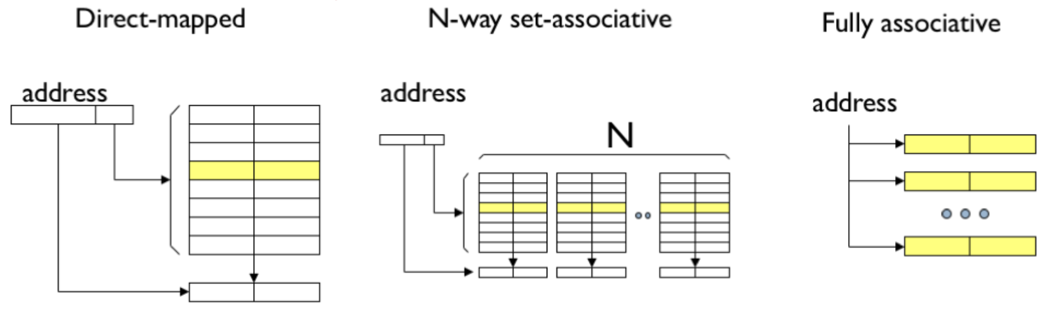
Cache Organization

Slide 6
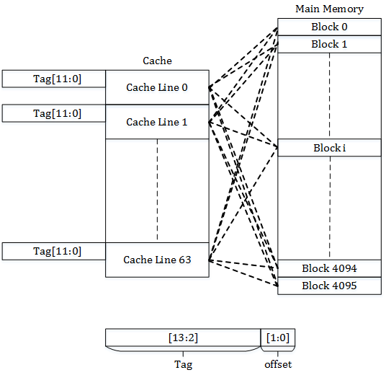
Fully Associative Cache
Allow any recently used data into the cache, no mapping for where it is placed.
Consider it as a n-way set associative cache, with n many cache blocks.
Access time is very slow since the cache lookup hardware is more complex (a comparator for every cache line).

Slide 7
Fully Associative Cache Example
Way 0
Way 1
Way 2
Way 3
Tag | Valid | Data
... | 0 | ...
Tag | Valid | Data
0100 | 1 | ...
Tag | Valid | Data
... | 0 | ...
Tag | Valid | Data
1111 | 1 | ...
Tag | Offset
4 bits | 4 bits
Mem Access 1
0x47: 0b01000111
What happens?

Slide 8
Fully Associative Cache Example
Way 0
Way 1
Way 2
Way 3
Tag | Valid | Data
... | 0 | ...
Tag | Valid | Data
0100 | 1 | ...
Tag | Valid | Data
... | 0 | ...
Tag | Valid | Data
1111 | 1 | ...
Tag | Offset
0100 | 0111
Cache Hit!
Every block is simultaneously queried for a matching tag
Mem Access 1
0x47: 0b01000111

Slide 9
Fully Associative Cache Example
Way 0
Way 1
Way 2
Way 3
Tag | Valid | Data
... | 0 | ...
Tag | Valid | Data
0100 | 1 | ...
Tag | Valid | Data
... | 0 | ...
Tag | Valid | Data
1111 | 1 | ...
Tag | Offset
4 bits | 4 bits
Mem Access 2
0x79: 0b01111001
What happens?

Slide 10
Fully Associative Cache Example
Way 0
Way 1
Way 2
Way 3
Tag | Valid | Data
... | 0 | ...
Tag | Valid | Data
0100 | 1 | ...
Tag | Valid | Data
... | 0 | ...
Tag | Valid | Data
1111 | 1 | ...
Tag | Offset
0111 | 1001
Cache Miss!
No valid block in our cache has a matching tag
Mem Access 2
0x79: 0b01111001

Slide 11
Fully Associative Cache Example
Way 0
Way 1
Way 2
Way 3
Tag | Valid | Data
... | 0 | ...
Tag | Valid | Data
0100 | 1 | ...
Tag | Valid | Data
0111 | 1 | ...
Tag | Valid | Data
1111 | 1 | ...
Find any empty line in the cache to allocate the block and update the metadata
Tag | Offset
0111 | 1001
Mem Access 2
0x79: 0b01111001

Slide 12
Fully Associative Cache Example
Way 0
Way 1
Way 2
Way 3
Tag | Valid | Data
1000 | 1 | ...
Tag | Valid | Data
0100 | 1 | ...
Tag | Valid | Data
0000 | 1 | ...
Tag | Valid | Data
1111 | 1 | ...
Tag | Offset
0111 | 1001
What if there are no empty cache blocks??
Use a replacement policy! (discussed later)
Mem Access 2
0x79: 0b01111001

Slide 13
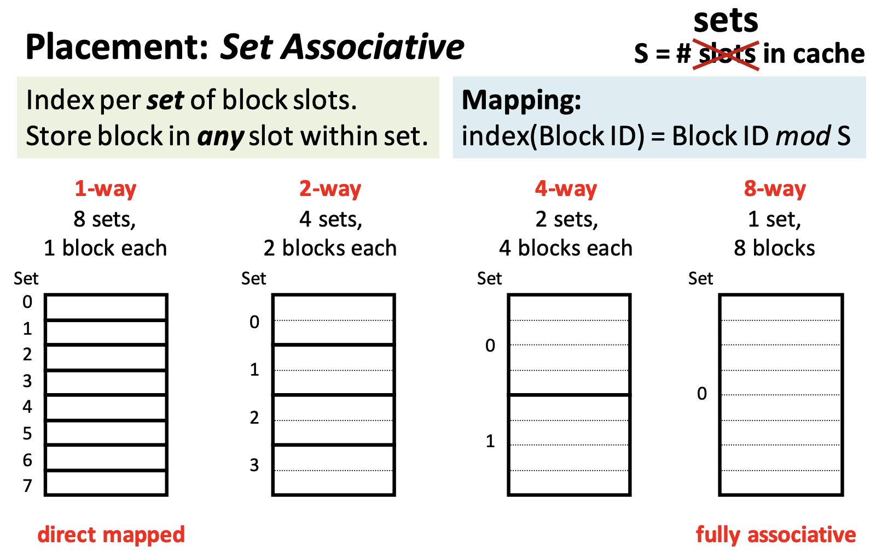
Set Associative Cache
Combines the best of both full associative and direct caches.
Allows for n entries to be directly mapped into a set in the cache for a n-way associative cache.

Slide 14
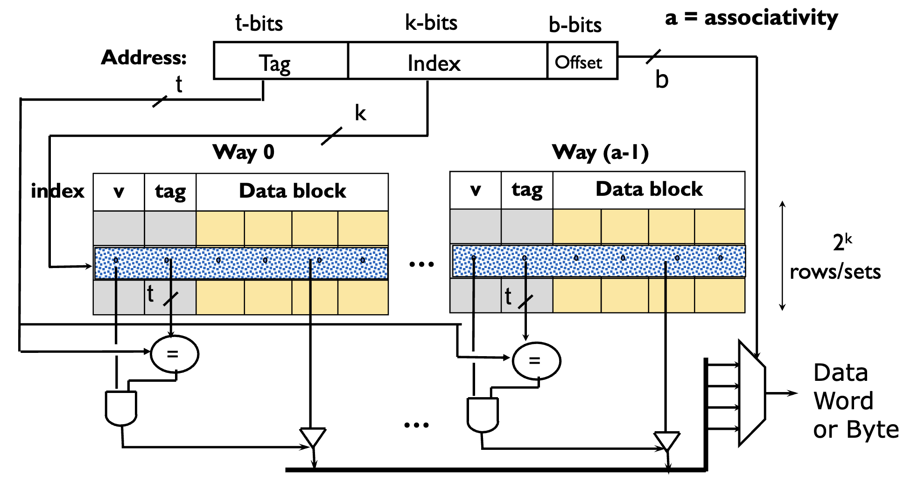
Set Associative Architecture

Slide 15
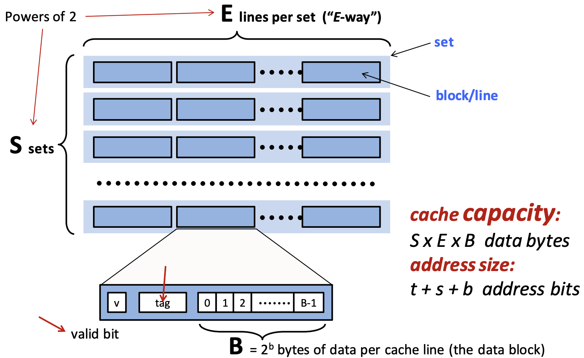
Cache Size and Cache Addresses

Slide 16
Set Associative Cache Address Example
Consider a byte-addressable memory system with 32-bit addresses, and a 8 KByte (1KByte = 1024 bytes) 4-way set associative cache with a block size of 64 bytes.
Calculate offset bits.
t-bits k-bits b-bits
Tag | Index | Offset

Slide 17
Set Associative Cache Address Example
Consider a memory system with 32-bit addresses, and a 8 KByte (1KByte = 1024 bytes) 4-way set associative cache with a block size of 64 bytes.
Calculate offset bits.
b = log2(block size) = log2(64) = 6
Calculate index bits.
t-bits k-bits 6-bits
Tag | Index | Offset

Slide 18
Set Associative Cache Address Example
Consider a memory system with 32-bit addresses, and a 8 KByte (1KByte = 1024 bytes) 4-way set associative cache with a block size of 64 bytes.
Calculate offset bits.
b = log2(block size) = log2(64) = 6
Calculate index bits.
k = log2(cache size/(associativity * block size))
= log2(8192 / (4 * 64)) = 5
Calculate tag bits.
t-bits 5-bits 6-bits
Tag | Index | Offset

Slide 19
Set Associative Cache Address Example
Consider a memory system with 32-bit addresses, and a 8 KByte (1KByte = 1024 bytes) 4-way set associative cache with a block size of 64 bytes.
Calculate offset bits.
b = log2(block size) = log2(64) = 6
Calculate index bits.
k = log2(cache size/(associativity * block size))
= log2(8192 / (4 * 64)) = 5
Calculate tag bits.
t = 32 bit address - k - b = 21
21-bits 5-bits 6-bits
Tag | Index | Offset

Slide 20
2-Way Set Associative Cache Example
Way 0
Way 1
Tag | Valid | Data
... | 0 | ...
... | 0 | ...
... | 0 | ...
... | 0 | ...
Tag | Valid | Data
... | 0 | ...
... | 0 | ...
... | 0 | ...
... | 0 | ...
Set0: 00
Set1: 01
Set2: 02
Set3: 03
Tag | Index | Offset
4 bits | 2 bits | 2 bits

Slide 21
2-Way Set Associative Cache Example
Way 0
Way 1
Tag | Valid | Data
... | 0 | ...
... | 0 | ...
... | 0 | ...
... | 0 | ...
Tag | Valid | Data
... | 0 | ...
... | 0 | ...
... | 0 | ...
... | 0 | ...
Set0: 00
Set1: 01
Set2: 02
Set3: 03
Tag | Index | Offset
4 bits | 2 bits | 2 bits
Mem Access 1
0x72: 0b01110010

Slide 22
2-Way Set Associative Cache Example
Way 0
Way 1
Tag | Valid | Data
... | 0 | ...
... | 0 | ...
... | 0 | ...
... | 0 | ...
Tag | Valid | Data
... | 0 | ...
... | 0 | ...
... | 0 | ...
... | 0 | ...
Set0: 00
Set1: 01
Set2: 02
Set3: 03
Tag | Index | Offset
0111 | 00 | 10
Mem Access 1
0x72: 0b01110010

Slide 23
2-Way Set Associative Cache Example
Way 0
Way 1
Tag | Valid | Data
... | 0 | ...
... | 0 | ...
... | 0 | ...
... | 0 | ...
Tag | Valid | Data
... | 0 | ...
... | 0 | ...
... | 0 | ...
... | 0 | ...
Set0: 00
Set1: 01
Set2: 02
Set3: 03
Tag | Index | Offset
0111 | 00 | 10
Mem Access 1
0x72: 0b01110010
What will happen?

Slide 24
2-Way Set Associative Cache Example
Way 0
Way 1
Tag | Valid | Data
... | 0 | ...
... | 0 | ...
... | 0 | ...
... | 0 | ...
Tag | Valid | Data
... | 0 | ...
... | 0 | ...
... | 0 | ...
... | 0 | ...
Set0: 00
Set1: 01
Set2: 02
Set3: 03
Cache Miss!
No valid blocks in the set
Tag | Index | Offset
0111 | 00 | 10
Mem Access 1
0x72: 0b01110010

Slide 25
2-Way Set Associative Cache Example
Way 0
Way 1
Tag | Valid | Data
0111 | 1 | ...
... | 0 | ...
... | 0 | ...
... | 0 | ...
Tag | Valid | Data
... | 0 | ...
... | 0 | ...
... | 0 | ...
... | 0 | ...
Set0: 00
Set1: 01
Set2: 02
Set3: 03
Cache Miss!
Overwrite an invalid block in our cache if possible
Tag | Index | Offset
0111 | 00 | 10
Mem Access 1
0x72: 0b01110010

Slide 26
2-Way Set Associative Cache Example
Way 0
Way 1
Tag | Valid | Data
0111 | 1 | ...
... | 0 | ...
... | 0 | ...
... | 0 | ...
Tag | Valid | Data
... | 0 | ...
... | 0 | ...
... | 0 | ...
... | 0 | ...
Set0: 00
Set1: 01
Set2: 02
Set3: 03
Tag | Index | Offset
4 bits | 2 bits | 2 bits
Mem Access 2
0xD3: 0b11010011

Slide 27
2-Way Set Associative Cache Example
Way 0
Way 1
Tag | Valid | Data
0111 | 1 | ...
... | 0 | ...
... | 0 | ...
... | 0 | ...
Tag | Valid | Data
... | 0 | ...
... | 0 | ...
... | 0 | ...
... | 0 | ...
Set0: 00
Set1: 01
Set2: 02
Set3: 03
Tag | Index | Offset
4 bits | 2 bits | 2 bits
Mem Access 2
0xD3: 0b11010011
What will happen?

Slide 28
2-Way Set Associative Cache Example
Way 0
Way 1
Tag | Valid | Data
0111 | 1 | ...
... | 0 | ...
... | 0 | ...
... | 0 | ...
Tag | Valid | Data
... | 0 | ...
... | 0 | ...
... | 0 | ...
... | 0 | ...
Set0: 00
Set1: 01
Set2: 02
Set3: 03
Another Cache Miss!
Allocate to way 1 because tag does not match way 0
Tag | Index | Offset
1101 | 00 | 11
Mem Access 2
0xD3: 0b11010011

Slide 29
2-Way Set Associative Cache Example
Way 0
Way 1
Tag | Valid | Data
0111 | 1 | ...
... | 0 | ...
... | 0 | ...
... | 0 | ...
Tag | Valid | Data
1101 | 1 | ...
... | 0 | ...
... | 0 | ...
... | 0 | ...
Set0: 00
Set1: 01
Set2: 02
Set3: 03
Another Cache Miss!
Allocate to way 1 because tag does not match way 0
Tag | Index | Offset
1101 | 00 | 11
Mem Access 2
0xD3: 0b11010011

Slide 30
2-Way Set Associative Cache Example
Way 0
Way 1
Tag | Valid | Data
0111 | 1 | ...
... | 0 | ...
... | 0 | ...
... | 0 | ...
Tag | Valid | Data
1101 | 1 | ...
... | 0 | ...
... | 0 | ...
... | 0 | ...
Set0: 00
Set1: 01
Set2: 02
Set3: 03
Tag | Index | Offset
4 bits | 2 bits | 2 bits
Mem Access 3
0x70: 0b01110000
What will happen?

Slide 31
2-Way Set Associative Cache Example
Way 0
Way 1
Tag | Valid | Data
0111 | 1 | ...
... | 0 | ...
... | 0 | ...
... | 0 | ...
Tag | Valid | Data
1101 | 1 | ...
... | 0 | ...
... | 0 | ...
... | 0 | ...
Set0: 00
Set1: 01
Set2: 02
Set3: 03
Tag | Index | Offset
0111 | 00 | 00
Cache Hit!
Hit because tag matches entry in way 0
Mem Access 3
0x70: 0b01110000

Slide 32
2-Way Set Associative Cache Example
Way 0
Way 1
Tag | Valid | Data
0111 | 1 | ...
... | 0 | ...
... | 0 | ...
... | 0 | ...
Tag | Valid | Data
1101 | 1 | ...
... | 0 | ...
... | 0 | ...
... | 0 | ...
Set0: 00
Set1: 01
Set2: 02
Set3: 03
Tag | Index | Offset
4 bits | 2 bits | 2 bits
Mem Access 4
0x31: 0b00110001
What will happen?

Slide 33
2-Way Set Associative Cache Example
Way 0
Way 1
Tag | Valid | Data
0111 | 1 | ...
... | 0 | ...
... | 0 | ...
... | 0 | ...
Tag | Valid | Data
1101 | 1 | ...
... | 0 | ...
... | 0 | ...
... | 0 | ...
Set0: 00
Set1: 01
Set2: 02
Set3: 03
Tag | Index | Offset
0011 | 00 | 01
Miss!
No match to any tag in set 0
Mem Access 4
0x31: 0b00110001

Slide 34
2-Way Set Associative Cache Example
Way 0
Way 1
Tag | Valid | Data
0111 | 1 | ...
... | 0 | ...
... | 0 | ...
... | 0 | ...
Tag | Valid | Data
0011 | 1 | ...
... | 0 | ...
... | 0 | ...
... | 0 | ...
Set0: 00
Set1: 01
Set2: 02
Set3: 03
Use replacement policy to select a “victim” block within the set and replace it
Tag | Index | Offset
0011 | 00 | 01
Mem Access 4
0x31: 0b00110001

Slide 35
2-Way Set Associative Cache Calculation Example
Way 0
Way 1
Tag | Valid | Data
0101 | 1 | ...
... | 0 | ...
1111 | 1 | ...
0101 | 1 | ...
Tag | Valid | Data
... | 0 | ...
... | 0 | ...
1010 | 1 | ...
1100 | 1 | ...
Set0: 00
Set1: 01
Set2: 02
Set3: 03
Tag | Index | Offset
4-bits | 2-bits | 2-bits
What is the total number of bits needed for this cache?
(Hint: cache capacity + cache metadata)

Slide 36
2-Way Set Associative Cache Calculation Example
Way 0
Way 1
Tag | Valid | Data
0101 | 1 | ...
... | 0 | ...
1111 | 1 | ...
0101 | 1 | ...
Tag | Valid | Data
... | 0 | ...
... | 0 | ...
1010 | 1 | ...
1100 | 1 | ...
Set0: 00
Set1: 01
Set2: 02
Set3: 03
Block size = 2^(offset bits) = 2^2 = 4 bytes
Number blocks = associativity * number sets = 2 * 4 = 8
Cache size = 8 * 4 bytes = 32 bytes = 256 bits
Metadata size = 8 * (4 bit tag + 1 bit valid) = 40 bits
Total size = 256 bits + 40 bits = 296 bits
Tag | Index | Offset
4-bits | 2-bits | 2-bits

Slide 37
Multi-Level Memory Hierarchy

Slide 38
Exercise : Calculate the EMAT
CPU
h1 = 0.9, T_{L1} = 1 ns
h2 = 0.6, T_{L2} = 5 ns
T_{m} = 100 ns
L1 Cache
L2 Cache
Main Memory

Slide 39
Solution : Calculate the EMAT
CPU
h1 = 0.9, T_{L1} = 1 ns
h2 = 0.6, T_{L2} = 5 ns
T_{m} = 100 ns
EMAT_{L2} = T_{L2} + ( 1 - h2 ) * T_{m} = 5 + (1 - 0.6) * 100 = 45
L1 Cache
L2 Cache
Main Memory

Slide 40
Solution : Calculate the EMAT
CPU
h1 = 0.9, T_{L1} = 1 ns
h2 = 0.6, T_{L2} = 5 ns
T_{m} = 100 ns
EMAT_{L2} = T_{L2} + ( 1 - h2 ) * T_{m} = 5 + (1 - 0.6) * 100 = 45
EMAT_{L1} = T_{L1} + ( 1 - h1 ) * EMAT_{L2} = 1 + (1 - 0.9) * 45 = 5.5 ns
L1 Cache
L2 Cache
Main Memory

Slide 41
Solution : Calculate the EMAT
CPU
h1 = 0.9, T_{L1} = 1 ns
h2 = 0.6, T_{L2} = 5 ns
T_{m} = 100 ns
EMAT_{L2} = T_{L2} + ( 1 - h2 ) * T_{m} = 5 + (1 - 0.6) * 100 = 45
EMAT_{L1} = T_{L1} + ( 1 - h1 ) * EMAT_{L2} = 1 + (1 - 0.9) * 45 = 5.5 ns
EMAT = EMAT_{L1} = 5.5 ns
L1 Cache
L2 Cache
Main Memory

Slide 42
Multi-Level Memory Hierarchy
EMAT Explained: EMAT stands for Effective Memory Access Time. It quantifies the average time required to read or write data to or from memory, considering factors like cache hits, cache misses, and data transfer time.
Role in Memory Hierarchy: EMAT is crucial in multi-level memory hierarchies, where different storage levels (registers, cache, main memory, disk) have varied access times. It offers a weighted average to optimize system performance.
Multi-Level Memory Hierarchy: A structured organization of storage that layers different types of memory based on speed and cost. Fast but expensive memory types are closer to the CPU, while slower and more affordable types are further away, aiming for an optimized EMAT.

Slide 43
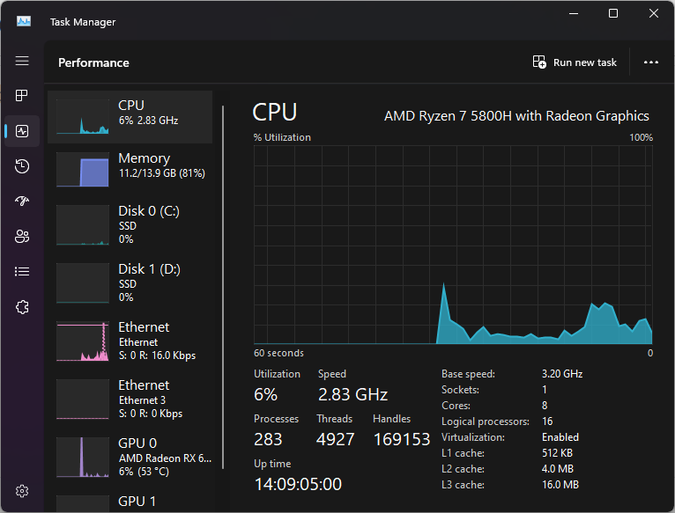
Check your own cache hierarchy in Task Manager!
Notice how caches get bigger (and hence slower) further away from the CPU

Slide 44
Cache Replacement Policy

Slide 45
How do we replace entries when cache set is full?
Belady’s Min - Optimum cache replacement algorithm that "looks into the future and evicts the entry needed furthest into the future (impossible in practice)
Random - randomly select an entry to evict
FIFO - Maintain a queue and evict the cache block at the head
LRU - Evict the entry that was used least recently

Slide 46
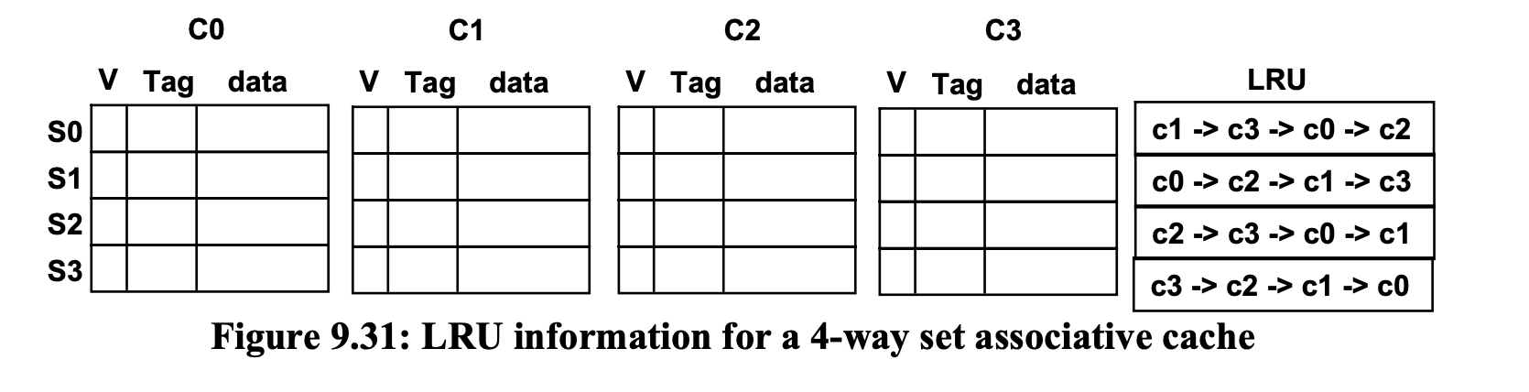
LRU Cache Replacement policy
If we need to replace a block how do we know which one to select for replacement?
We can use a LRU scheme to keep track of which blocks were referenced more recently in order to take advantage of temporal locality similar to what we did for demand paging
We can keep track of this information with a LRU vector which orders blocks within a set based on when it was last referenced
4 ways = 4! Possible orderings of the LRU ordering vector
5 bits minimum for 24 states.

Slide 47
Cache Write Policy

Slide 48
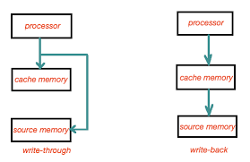
Write-Through vs Write-Back
Write-Through: Writes to both the cache-line and the next level of memory concurrently.
Allows the next level of cache to always be up to data.
However creates a lot of memory traffic.
Write-Back: The value is written only to the cache line. The modified cache line is written to next memory level only when evicted.
Reduces memory traffic, by buffering writes.
Memory value in the next level may be stale or not up to date.

Slide 49
Cache Coherency Policy

Slide 50
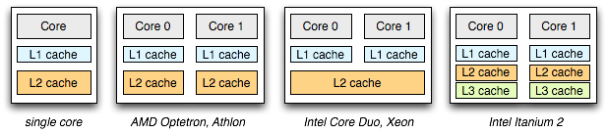
Multi-Core Caching
With multi-core processors, organizing caching hierarchies can be pretty interesting, since some cache may be private or shared between multiple cores. However since they all access the same memory, the data between the caches must be coherent, and be up-to date with new data.

Slide 51
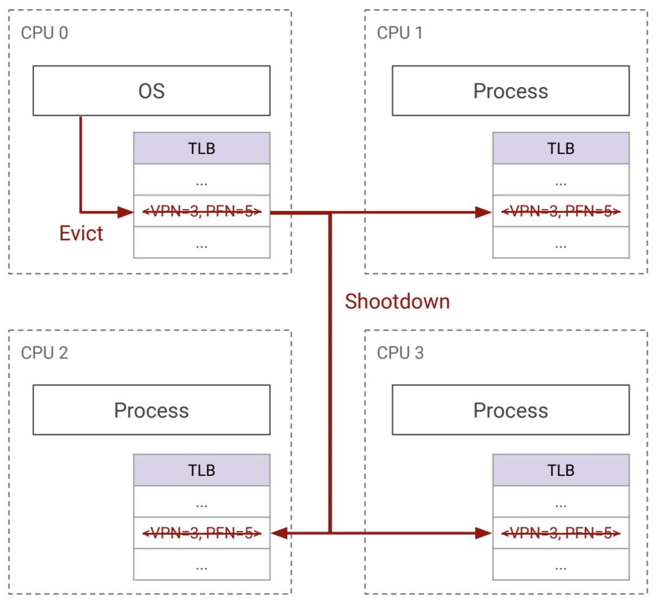
Coherence Protocols
Write-invalidate: an invalidate message is sent to all caches that are snooping on the bus, making their cache entries no longer valid. This requires processors to check each others caches for the valid cache entry.
Write-update: each cache will broadcast the data in the cache entry, and each processor will update locally.

Slide 52
Caching and Virtual Memory

Slide 53
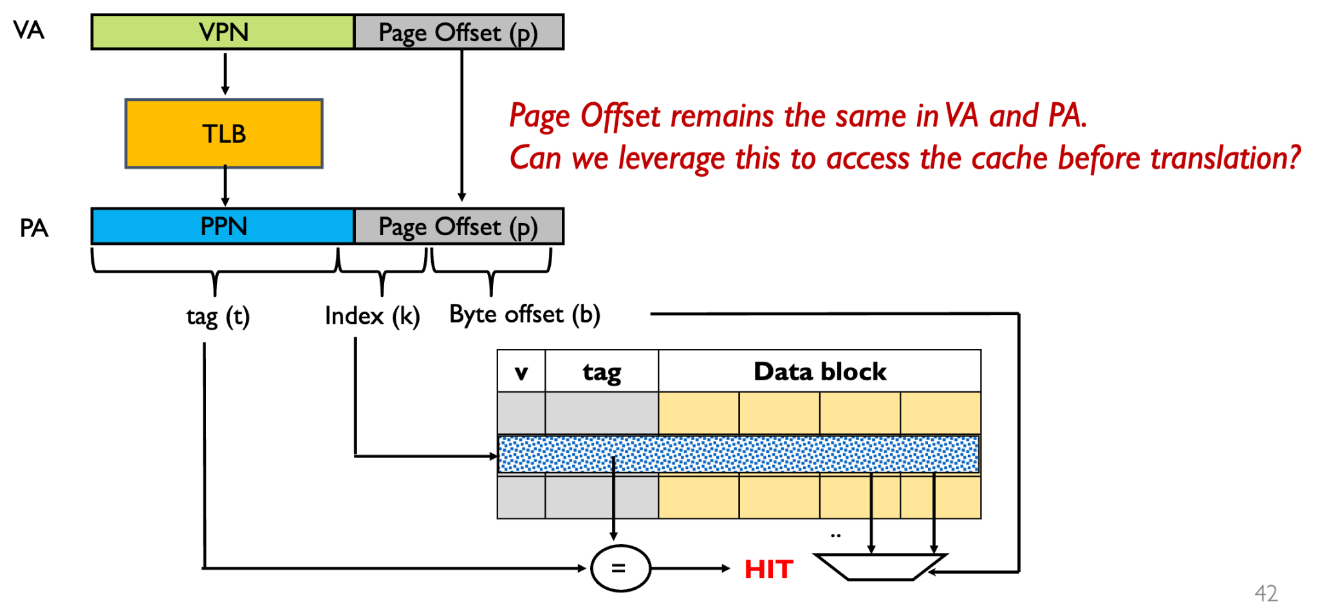
Physically Indexed - Physically Tagged (PIPT) Cache

Slide 54
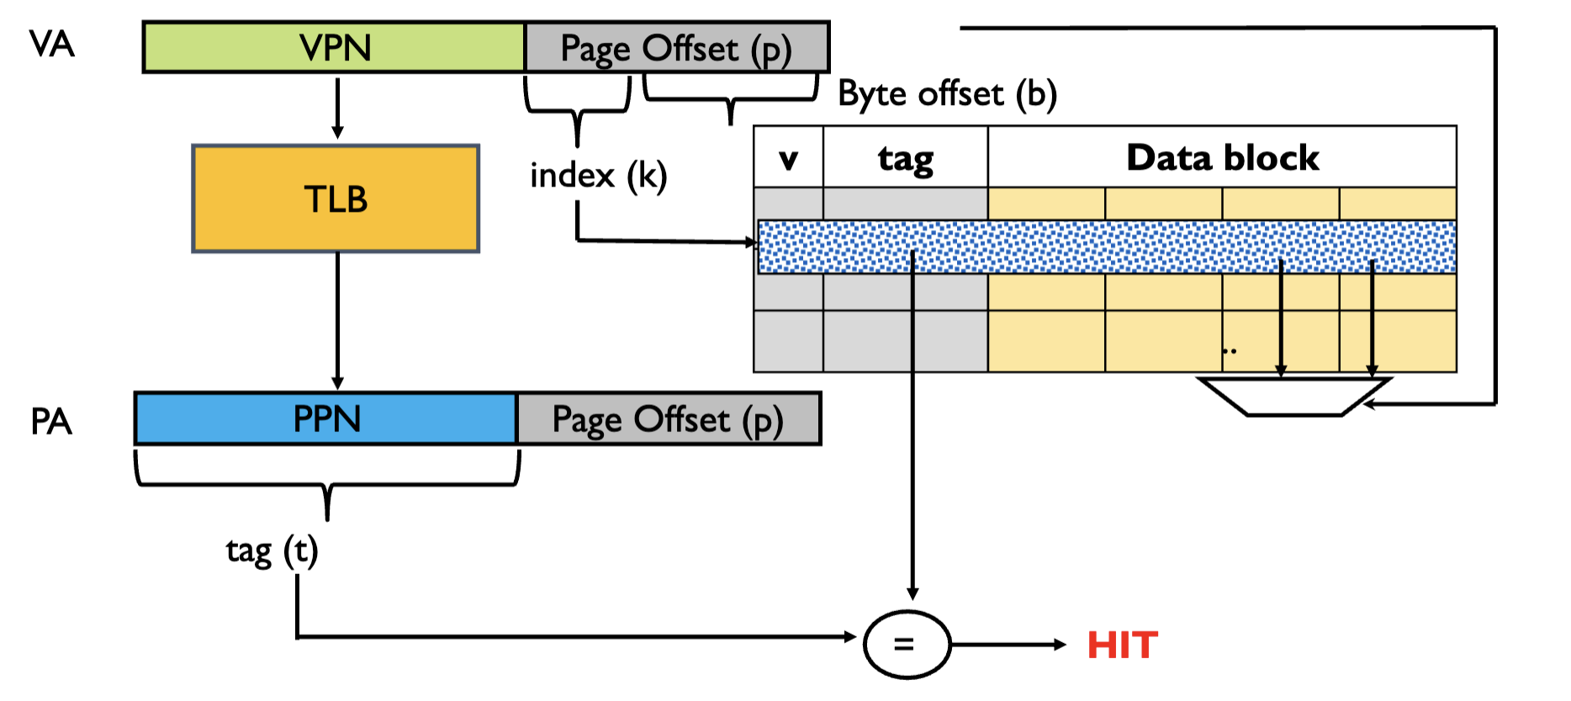
Virtually Indexed - Physically Tagged (VIPT) Cache

Slide 55
Project 4 Questions?

Slide 56
Thanks for Attending :)

